Slide 1
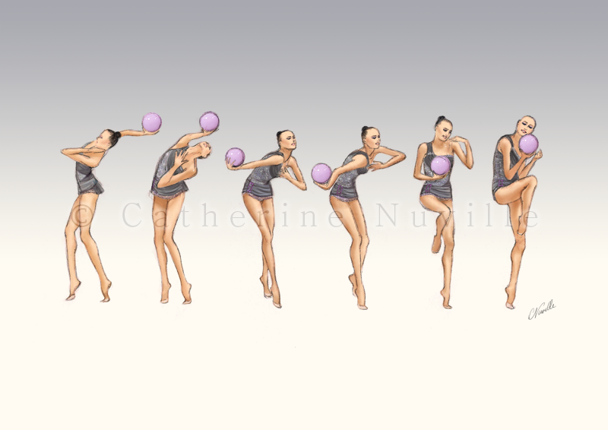
Skills Learning Lab
Waves in the ALP
Notes:
GA_I_M1_U1
1

Slide 2
Wave (W)
A full body wave is a sequential contraction and decontraction of all the muscles of the body, along the “chain” of body segments like an “electric current,” from the head, through the pelvis, to the feet (or vice-versa).
The participation of the arms are determined by the apparatus handling and/or choreography.
Each exercise must have 2 full body waves (W).
Exemption Level 1 and 2 only require 1 full body wave (W).

Slide 3
The full body wave (W) may be;
From the Difficulty Tables 11 (#28) and Difficulty Table 13 (#4) in the Code of Points; a Fundamental or Non-Fundamental apparatus element is required for full body waves which are DB in the DB Tables.
Full body waves which are modifications of DB waves (planes, start positions, leg positions, arm movements, etc that are different than the definitions in the DB Tables) may be performed provided that the wave is performed by the whole body.
Full body waves which are modifications of DB waves do not require Fundamental or non Fundamental Apparatus Elements; the apparatus must be in motion (not static). These types of full body waves (modifications of DB) may be repeated.

Slide 4
W Checklist
The Whole Body Participates
Sequential Movement
Contraction AND Decontraction
Sufficient apparatus handling
- DB Wave; 1 Apparatus Technical Element
- Other Waves: Apparatus in motion
If the whole body participates, but some segments have insufficient amplitude;
W valid
Execution penalty
Body waves must be performed separately from each other
An exercise with less than 2 full body waves will be penalized 0.30 for each missing wave.

Slide 5
W Examples

Slide 6
Let’s Compare
The whole body must participate
Sequential movement required
Contraction AND decontraction required
If the whole body participates, but some segments have insufficient amplitude:
Wave Valid
Execution Penalty

Slide 7
Let’s Compare
The whole body must participate
Sequential movement required
Contraction AND decontraction required
If the whole body participates, but some segments have insufficient amplitude:
Wave Valid
Execution Penalty

Slide 8
Let’s Compare
The whole body must participate
Sequential movement required
Contraction AND decontraction required
If the whole body participates, but some segments have insufficient amplitude:
Wave Valid
Execution Penalty

Slide 9
Thank you
A sincere thank you to the coaches and athletes who contributed to these learning resources.
Questions or Suggestions?
Please reach out to the JA at rgja@gymnsw.org.au or our EPPO at rg@gymnsw.org.au if you have any further questions or a suggestion for the next Skills Learning Lab.

